Slide 1


Time Series Analysis & Forecasting
Nadav Rindler nrindler@gmail.com
Session 16
15 Oct 2017

Slide 2
Time Series
Time series – observations over time – an ordered sequence of values of a variable at equally spaced time intervals
Time series analysis comprises methods for analyzing time series data in order to extract meaningful statistics and other characteristics of the data
Time series models seek to:
Forecast future values based on the assumption that future values are a function of current and past values
Estimate true values in the presence of noise or trend

Slide 3
Why do time series matter?
Extremely wide usage across industries and domains:
Stock market
Weather and climate
Population and demographics
Forecasting revenue and costs
Signal processing
Operations research: inventory projections, industrial processes, quality control
Any economic series …
“Prediction is very difficult, especially if it’s about the future”
– Nobel laureate Nils Bohr

Slide 4
Concepts
Autocorrelation
Moving Average
Component analysis
Regression
Fourier Transform – Periodicity
Exponential Smoothing
Exponential Smoothing and Prediction of Time Series
ARIMA–Models
Analysis of Autocorrelations and Partial Autocorrelations
Parameter–Estimation of ARIMA–Models
Diagnostic Checking
Prediction of ARIMA–Models

Slide 5
Autocorrelation
Time series data have autocorrelation, or correlation between adjacent observations, which breaks from conventional statistical assumptions that data points are independent of one another and identically distributed (iid)
Regular statistical analysis concerned with estimations of repeated samples. We often can’t do this for time series (e.g. temperature, stock market), so have to observe how values change over time

Slide 6
Stochastic Process
Process that evolves over time
A stochastic process is said to be ‘stationary’ if there is no trend in the data
This is a nice assumption because it implies the correlation of a process is fixed over time, i.e. any two points should have the same relationship

Slide 7
Time Intervals
Time series are often continuous by nature – we can observe values at any continuous point in time
However, in practice observations are collected at discrete intervals because of inherent limitations in our collection methods
Even high-frequency trading is recorded in units of microseconds, or millionths of a second!
Additionally, for analysis it’s often convenient to represent data as a finite set of data points
Appropriate sampling rate, or intervals between observations, is important

Slide 8
Moving Average
Smoothing – by setting value equal to:
Set of past X values
Moving window – current value and the X values before it and Y values after it
Apply weights to each value
Average – equal weights e.g., average of X prior values.
Recency – weight values closer in time to the current value more / less
Other – select specific weights for each value included in the moving average
Weights must total 1
Suffer from lag and smoothing extremes – larger the window, the less the moving average will hit the extremes, and the more it will be lagged
Very sensitive to the length of the window

Slide 9
Decomposition of Time Series
Decomposing a time series means separating it into its constituent components, namely:
Trend – long term progression of the series – increasing, decreasing, or stationary (none). Does not have to be linear
Seasonality – repeated pattern over time with fixed and known
Cyclical – repeated but non-periodic fluctuations. Typically long-term (e.g., El Niño)
Irregular / Noise – random and irregular component; the residuals (unexplained variance) after controlling for the other factors
Models can account for these components in an additive or multiplicative manner

Slide 10
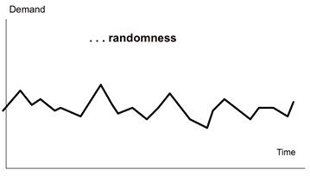
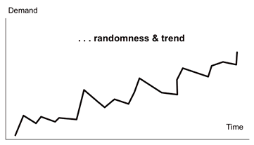
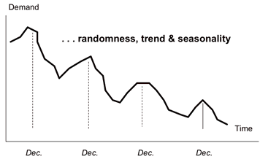
Randomness, Seasonality, and Trend

Slide 11
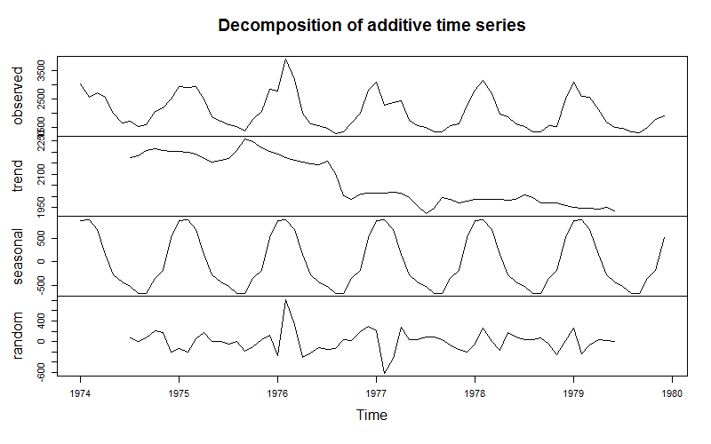
Visualize time series components

Slide 12
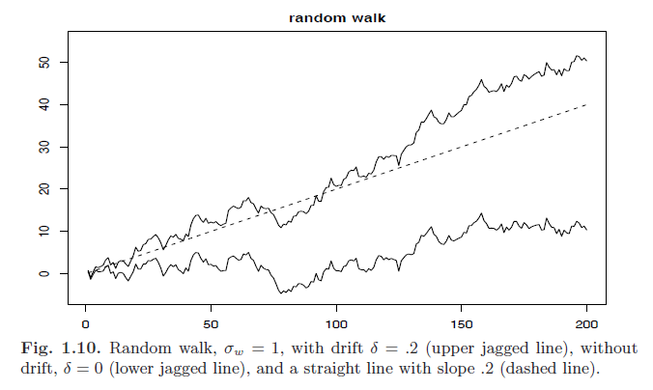
Random Walk
Value of the time series at time t equal to the value of the series at time t-1 plus a completely random movement, or white noise (w_{t})
y_{t} = ∂ + y_{t-1} + w_{t}
Delta (∂) is a constant value called drift. When ∂ is not equal to 0, the random walk series will have a linear trend
Source: Time Series w/R Textbook

Slide 13
How to detect and measure seasonality?
Fourier transform – Identify periods and their frequency and amplitude
Create sinusoidal patterns by wrapping a signal around a circle and drawing (decomposing) the result
Amplitude determined by diameter of the circle
Frequency determined by speed at which the signal moves around the circle
Harmonics – Combine multiple circles of varying diameter to create any pattern
https://www.youtube.com/watch?v=LznjC4Lo7lE
Periodogram – for each frequency, compute “power”. Frequencies which align with the data have high power, indicating frequency matches seasonality in data

Slide 14
Exponential Smoothing
Used to make short-term forecasts
Extension of moving average where past observations are weighted by recency (decreasing weight as obs gets older)
Can do this using geometric weights which create a discrete exponential function
x = input value; s = smoothed output; alpha = weight between 0 and 1
alpha: how much weight to give to the last point x_{t-1}? Smaller alpha >> smoother
𝑠₀ = 𝑥₀
𝑠₁ = 𝛼𝑥₁ + (1−𝛼)¹𝑥₀
𝑠₂ = 𝛼𝑥₂ + 𝛼(1−𝛼)¹𝑥₁ + (1−𝛼)²𝑥₀
𝑠₃ = 𝛼𝑥₃ + 𝛼(1−𝛼)¹𝑥₂ + (1−𝛼)²𝑥₁ + (1−𝛼)³𝑥₀
𝑐𝑜𝑒𝑓𝑓𝑖𝑐𝑖𝑒𝑛𝑡𝑠 = 1, (1−𝛼),(1−𝛼)², (1−𝛼)³, …
Double exponential smoothing – account for trend
Triple exponential smoothing – account for trend and seasonality

Slide 15
Linear Regression
Create predictors to represent the datetime values
Counters: Number of days / weeks / months / years since start of time series
Will reflect trend
Factors: Hour, day, week, month, season of year, year value
Will reflect seasonality – the highs and lows in a cycle
Indicators: 1/0 if Month==Jan, 1/0 if Month==Feb, etc.
Must have one less variable than the # of unique values, i.e. 11 cols for 12 mos
Will reflect the effect of that specific month relative to baseline month
Auto-regressive terms if neighboring points are still related
Add predictor equal to ‘time before’ and/or ‘2 times before’ obs (lagged value)
Integrated terms: Add predictor equal to the difference between two prior obs
Moving average: Add predictor equal to the average of the past X obs

Slide 16
Auto-Regressive (AR) model
Current value is linearly-dependent on previous values
Assumes presence of auto-correlation and no trend
corr(y_{t} , y_{t-k}) != 0 where k = number of periods lagged
Calculating corr(y_{t} , y_{t-k}) for each k generates the partial autocorrelation function (PACF), from which we can then select lags with high correlation
The order of an AR model is the number of immediately-preceding values used to predict current value, e.g. AR[1] uses only x_{t-1} to predict x_{t}
y_{t} = β₀ + β₁y_{t-1}+ϵ_{t}

Slide 17
Auto-Regressive Moving Average (ARMA) model
ARMA is simply the auto-regressive term plus the moving average
P: Order of AR (number of previous data points included in AR)
Q: Order of MA (number of previous data points included in MA)
ARMA(P,Q) = constant + AR + MA + error
y_{t} = β₀ + Σ_{i}^{P}(β_{i}y_{t-i}) + Σ_{i}^{Q}(θ_{i}x_{t-i}) + ϵ_{t}
Remember: Auto-regressive means regressing y on its own past values. Moving average means regressing y on past values of an independent variable x

Slide 18
Auto-Regressive Integrated Moving Average (ARIMA) model
ARIMA is simply ARMA plus a third term to account for trend (non-stationary)
Integrated time series (think integral) – look at the difference between points
First order is a random walk: Δy_{t} = ϵ_{t}
Second order is smoother random walk: y_{t} = (y_{t} - y_{t-1} ) – (y_{t-1 -} y_{t-2})+ ϵ_{t}
ARIMA has three terms
P: Order of AR
D: Degree of the integral needed to transform non-stationary to stationary
Q: Order of MA
ARIMA(P,D,Q) = AR + Integration Term + MA + error
What are:
ARIMA(0,0,0) ARIMA(0,0,1) ARIMA(0,1,0) ARIMA(0,1,1)
Notes:
Answer key (don’t cheat!)
ARIMA(0,0,0) = Random noise
ARIMA(0,0,1) = Moving average
ARIMA(0,1,0) = Random walk
ARIMA(0,1,1) = Simple exponential smoothing

Slide 19
Exercise
Create a dygraph of the Indonesia fire data – number of fires by day
Add series to dygraph: the 10-, 20-, and 50-day moving average of fires by day
Time series linear regression: model Klang Valley API using time series attributes and number of daily Indonesia fires
Evaluate forecast accuracy using Mean Absolute Percentage Error (MAPE)

Slide 20
References and Resources
Linear filtering / moving average / decomposition: http://www.stat.cmu.edu/~hseltman/618/LNTS3.pdf
Fourier transform: https://anomaly.io/detect-seasonality-using-fourier-transform-r/
Time series lecture with sample code, from University of Washington, DS350: Methods in Data Analysis
Time Series Analysis with Applications in R textbook
Little Book of R for Time Series

